Slide 1



Freedesktop-sdk maintaining complex systems the easy way

Slide 2
Contents
What is Freedesktop-sdk
  Use case: OS images
  Use case: Flatpak
Challenges
Solutions
Summary
Notes:
Name of a project, and also the name of the build output of the project

Slide 3
What is freedesktop-sdk ?
Project: Independent FOSS project, belonging to the freedesktop umbrella
Sponsored by Codethink, ARM, OSU-OSL, FOSSHOST and others
Output: freedesktop-sdk can be used as a base for several use cases:
  Generate OS images on top of it
  Flatpak runtimes (around 1M users, 25000 downloads per day)
  Other (container images, snaps, etc)
Project integrates 564 software components
  From userspace and graphical/multimedia stack, down to compilers and libc libraries
Major release each year, minor point releases every ~2 weeks
Notes:
Name of a project, and also the name of the build output of the project

Slide 4
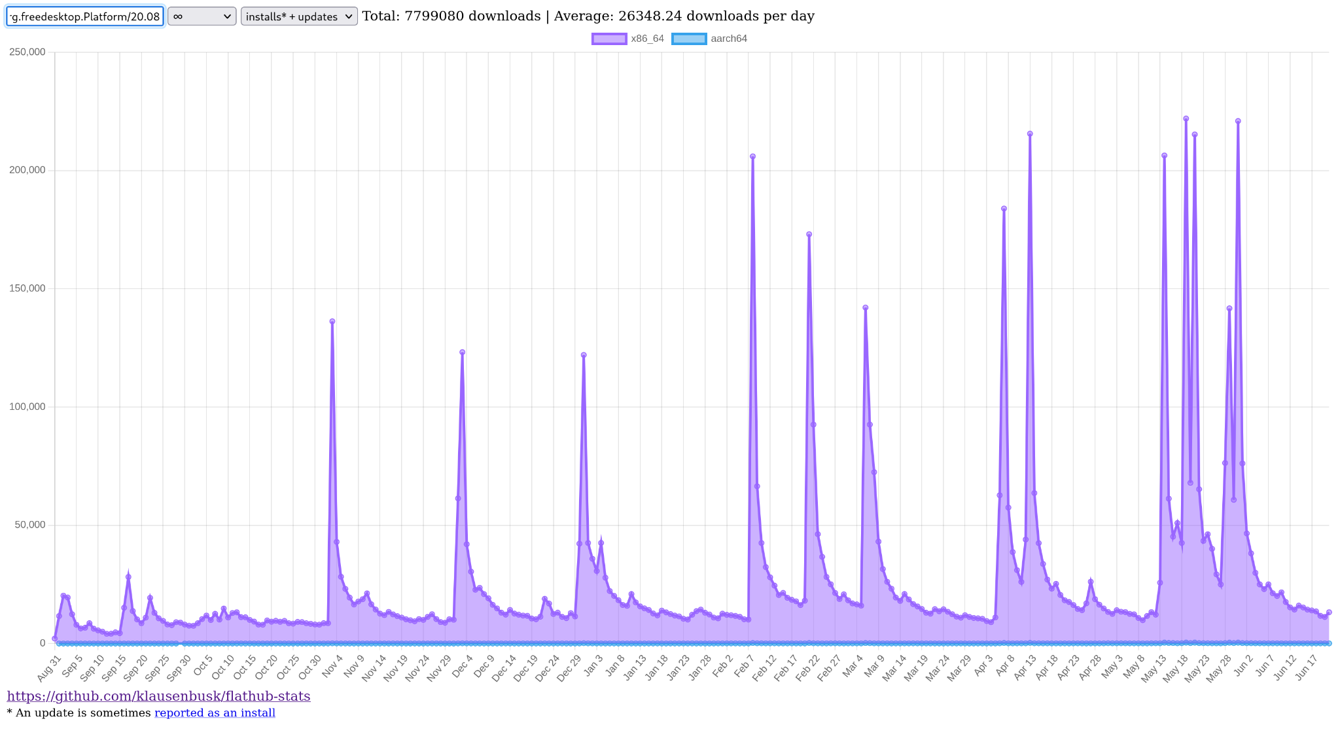
Contents
TODO
Notes:
Name of a project, and also the name of the build output of the project

Slide 5
What is freedesktop-sdk ?
Support for several hardware architectures;
  x86_64
  i686
  Aarch64
  ppc64le
  and recently RISC-V! (will be officially available in next stable release)
Project makes heavy use of CI for all the integration processes
  Mainline is always green (pre-merge CI jobs)
  Fully automated release process; only thing needed is a tag in the corresponding git repository to deploy to all supported architectures
  Around an hour from being tagged to be build and deliver in all architectures
Notes:
Name of a project, and also the name of the build output of the project
CI deploys to all architectures

Slide 6
Use case: creating OS images
You can create your custom OS image using freedesktop-sdk as a base and building on top
For example, GNOME build its testing OS images using freedesktop-sdk in this way
It should be as easy as this:
kind: junction
sources:
- kind: git_tag
url: https://gitlab.com/freedesktop-sdk/freedesktop-sdk.git
track: '19.08'
ref: freedesktop-sdk-19.08.10-10-g5d370d193ed075f322552afd0167fea8695a59c9
Notes:
Name of a project, and also the name of the build output of the project

Slide 7
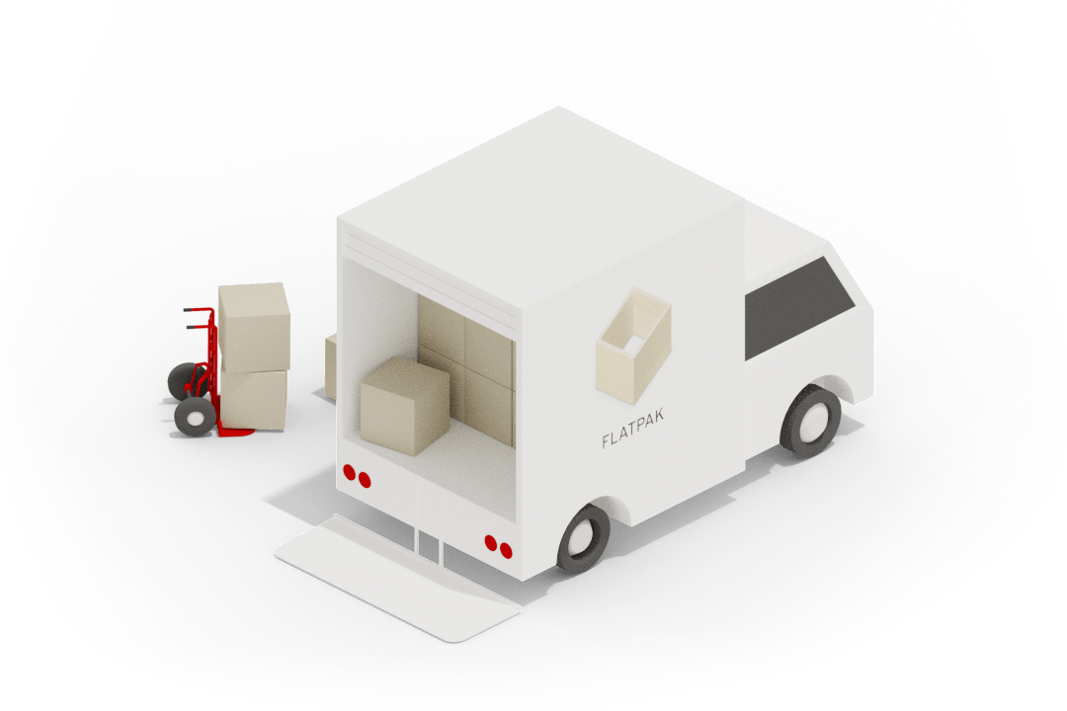
Use case: Flatpak
Modern Linux application framework (to build and distribute apps)
Can run on any distro
Sandboxing
Runtimes and apps separation
Runtimes provide stable platforms of common libraries that you can depend on.

Slide 8
Flatpak
Gnome-sdk
KDE-sdk
Freedesktop-sdk

Slide 9
Flatpak
Flatpak
App
(Nautilus)
Gnome-sdk
KDE-sdk
Freedesktop-sdk

Slide 10
Flatpak
Flatpak
App
(Kdenlive)
Gnome-sdk
KDE-sdk
Freedesktop-sdk

Slide 11
Flatpak
Flatpak
App
(Steam)
Gnome-sdk
KDE-sdk
Freedesktop-sdk

Slide 12
Challenges
Huge ambition, limited resources (as per most FOSS projects)
Need full transparency and traceability of all changes at all times
Huge amount of components to be integrated from many different sources
Needed to generate several different outputs from the same inputs
Needed to ensure backwards and forwards ABI stability
Needed to keep track of security vulnerabilities and apply patches in the shortest possible time
Notes:
Being the friend of the infra team to be able to SSH into a machine and do some test builds

Slide 13
Challenge: limited resources

Slide 14
Solution: Automation and strong CI/CD
Mainline always green!!
Nothing can reach mainline without passing various tests:
  ABI check (for stable branches)
  Full build
  Miscellaneous quality of life checks
Git sources will automatically update to the latest version
Merges handled by a merge bot
Release process is as simple as tagging the repository
Minimise Human Error through good process
  Proposing changes is as easy as creating a branch and create a merge request
Notes:
Example MR: https://gitlab.com/freedesktop-sdk/freedesktop-sdk/-/merge_requests/5237

Slide 15
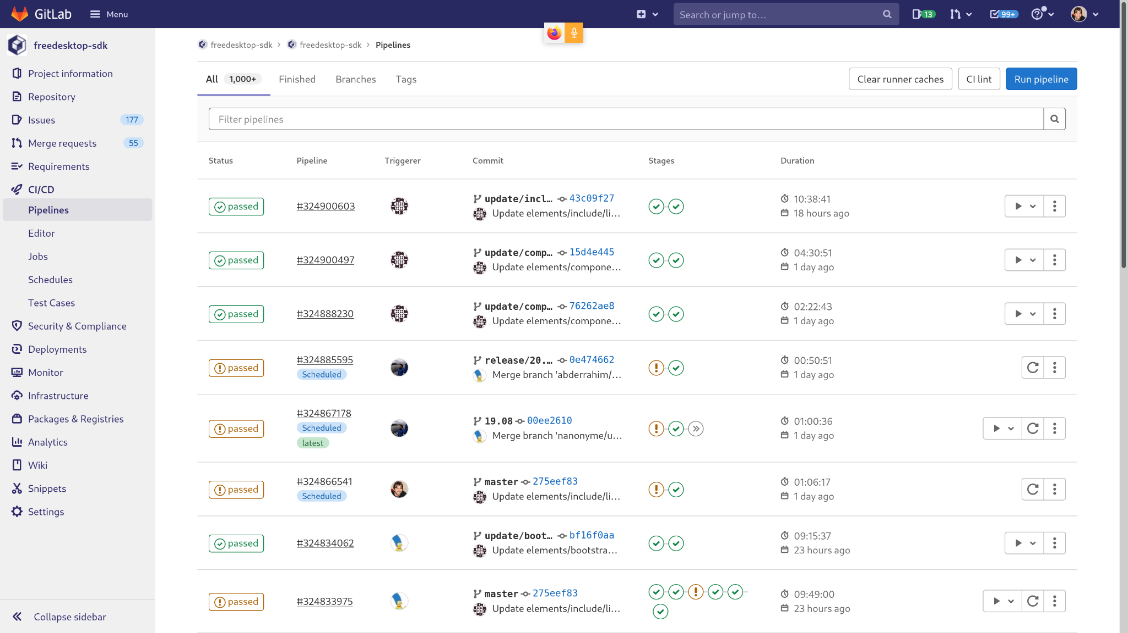
Solution: Automation and strong CI/CD
Notes:
Example MR: https://gitlab.com/freedesktop-sdk/freedesktop-sdk/-/merge_requests/5237

Slide 16
Challenge: traceability of all changes at all times

Slide 17
Solution: Provenance
BuildStream uses a declarative YAML format for sources
Each source is uniquely specified by the YAML used
This typically involves precise commits (for VCS) or checksums (for e.g. Tarballs)
Provenance information can be included in the final artifact
Exact build definitions are stored in git for fully traceable history
sources:
- kind: git_tag
url: kitware:cmake.git
track: master
exclude:
- "v*-rc*"
ref: 3.20.4-0-gb61fe6a831c72050c3a4f830445f98696b0cedf7
- kind: patch
path: patches/cmake/cmake-nolib64.patch
Notes:
ACTION: every single slide needs to finish on some summarising sentence such as ‘this is how you avoid XYZ’ or ‘this massively reduces your workload because…’

Slide 18
Solution: Repeatability
BuildStream’s sandbox covers most reproducibility issues
  Declarative YAML format ensures consistent environment
No host tooling touches the build
Mirrors of everything
Ensures freedesktop-sdk is as close as possible to building the exact same output
CI checks for verify reproducibility (currently at about 94% of all elements)
Build Definitions (YAML)
Build Output (Binaries)

Slide 19
Challenge: large amount of inputs and outputs

Slide 20
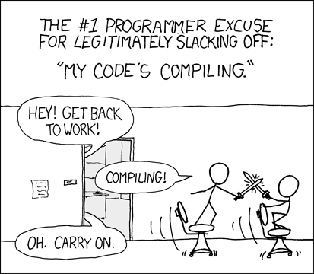
Solution: good integration tooling (1)
BuildStream
  Local caches in CI runners mean builds only rebuild what is necessary
  Cache keys are calculated from YAML inputs - no compilation required
Remote caching
  Leverages Remote Execution APIs to avoid rebuilds even without a local cache
Caches are deduplicated
Minimise CPU cycles and developer time
Source: https://xkcd.com/303

Slide 21


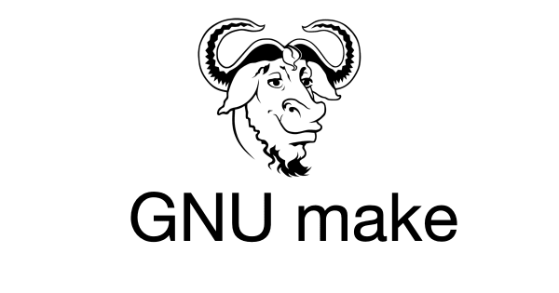
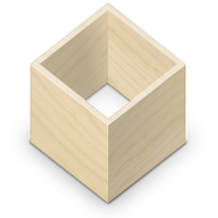
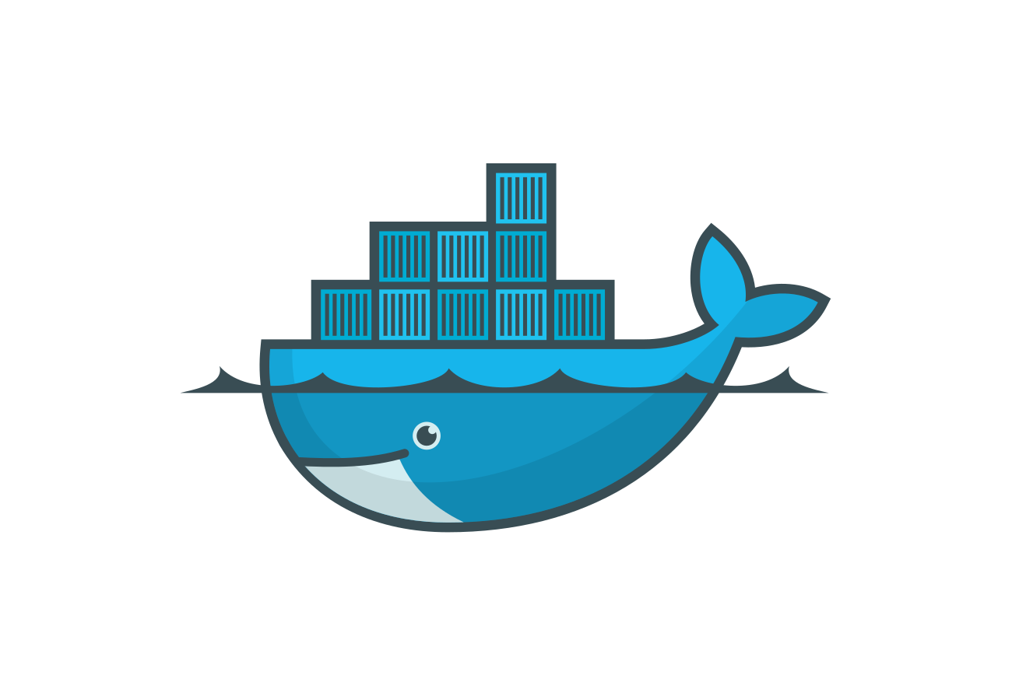
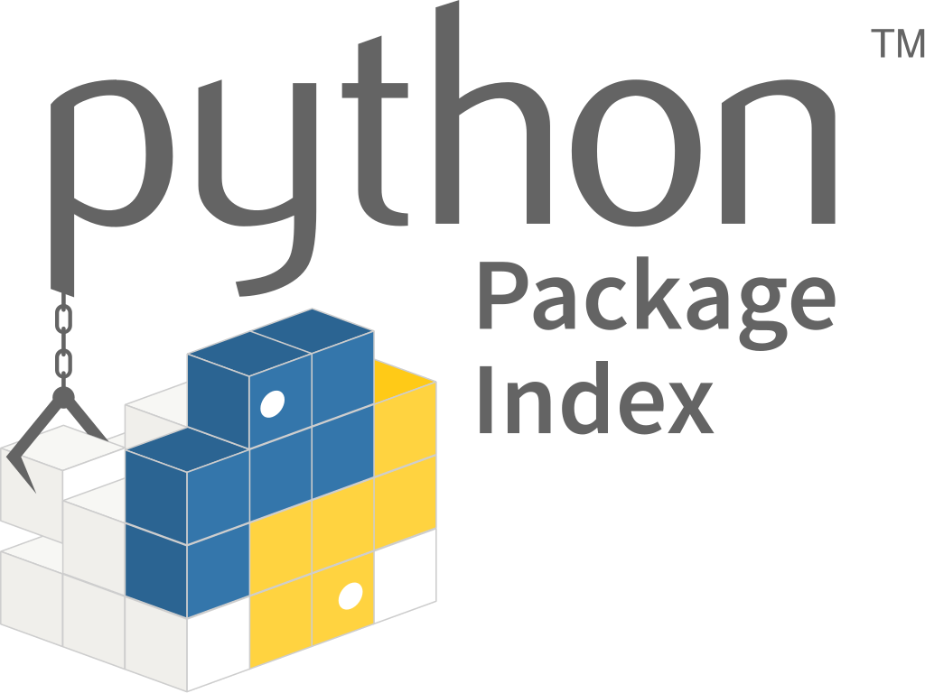


Solution: good integration tooling (2)
BuildStream is based on plugins
Wide variety of sources already
  Git, Tarball, Zip, Quilt, …
Allows a multitude of build systems
  GNU Make, CMake, GNU Autotools, Meson, …
Various types of output plugin
  Flatpak image, bootable OS image, Snap, Docker, …
Extensible - You can write your own

Slide 22
Challenge: ABI stability

Slide 23
Solution: ABI Checker
Need to avoid breaking backwards and forwards (!) ABI compatibility between stable releases
  Keeping backwards compatibility is relatively easy, forward compatibility is a harder problem
Use an ABI checker based on libabigail
If ABI breaks, then CI fails before merge
A human can then fix the problem
Strong compatibility guarantees

Slide 24
Challenge: security vulnerabilities

Slide 25
Solution: CVE Checker
Checks for known CVEs are run on each commit to mainline
Source definitions are automatically checked against the National Vulnerability Database
A report is generated ready for a human to check and find patches
No CVEs will be left unnoticed
Notes:
Example CVE report: https://freedesktop-sdk.gitlab.io/-/freedesktop-sdk/-/jobs/1369196305/artifacts/cve-reports/platform.html

Slide 26
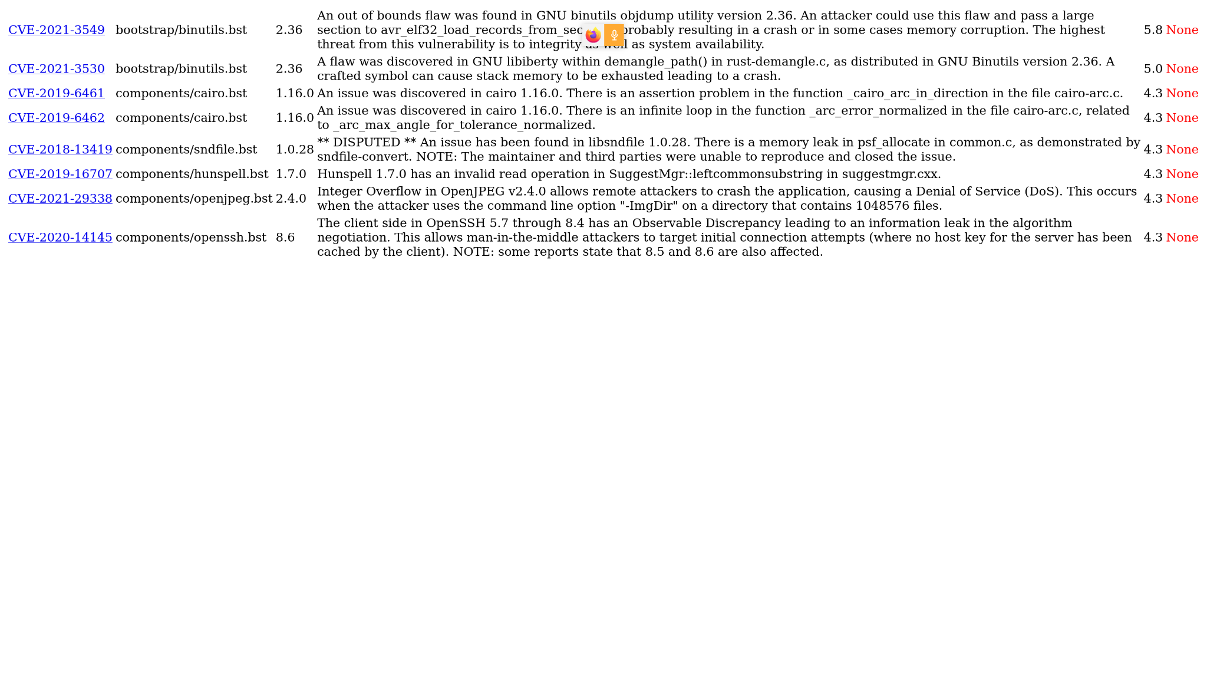
Solution: CVE Checker
Notes:
Example CVE report: https://freedesktop-sdk.gitlab.io/-/freedesktop-sdk/-/jobs/1369196305/artifacts/cve-reports/platform.html

Slide 27
Summary
Heavy automation for all the processes
  Low maintenance costs
  All the build / delivery process is automated
  Build and update 564 components and deliver artifacts for several different architectures several times per day
Use of bleeding edge integration tooling
Build process is public and available to everyone. Every change in the system is being tracked in git
Use a build system that support plugins to add support for different inputs and outputs
ABI checked as part of the CI
CVE checker as part of the CI

Slide 28
Thanks for listening!
Questions?
https://freedesktop-sdk.io/
https://codethink.co.uk

